Slide 1
QGIS
Вы слушаете:
Абрамова Дмитрия Валерьевича;
vk.com/dmbrmv

Slide 2
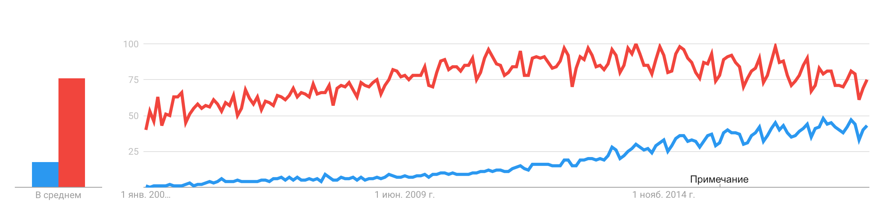

Что это ?
QGIS (previously known as Quantum GIS) is a free and open-source cross-platform desktop geographic information system (GIS) application that supports viewing, editing, and analysis of geospatial data (Wikipedia)
Development
Gary Sherman began development of Quantum GIS in early 2002, and it became an incubator project of the Open Source Geospatial Foundation in 2007. Version 1.0 was released in January 2009.
Written in C++, QGIS makes extensive use of the Qt library. In addition to Qt, required dependencies of QGIS include GEOS and SQLite. GDAL, GRASS GIS, PostGIS, and PostgreSQL are also recommended, as they provide access to additional data formats
Автор: Jarickkk - собственная работа, CC BY-SA 4.0
Динамика популярности QGIS и ArcGIS с 2004 до 2019 гг.

Slide 3
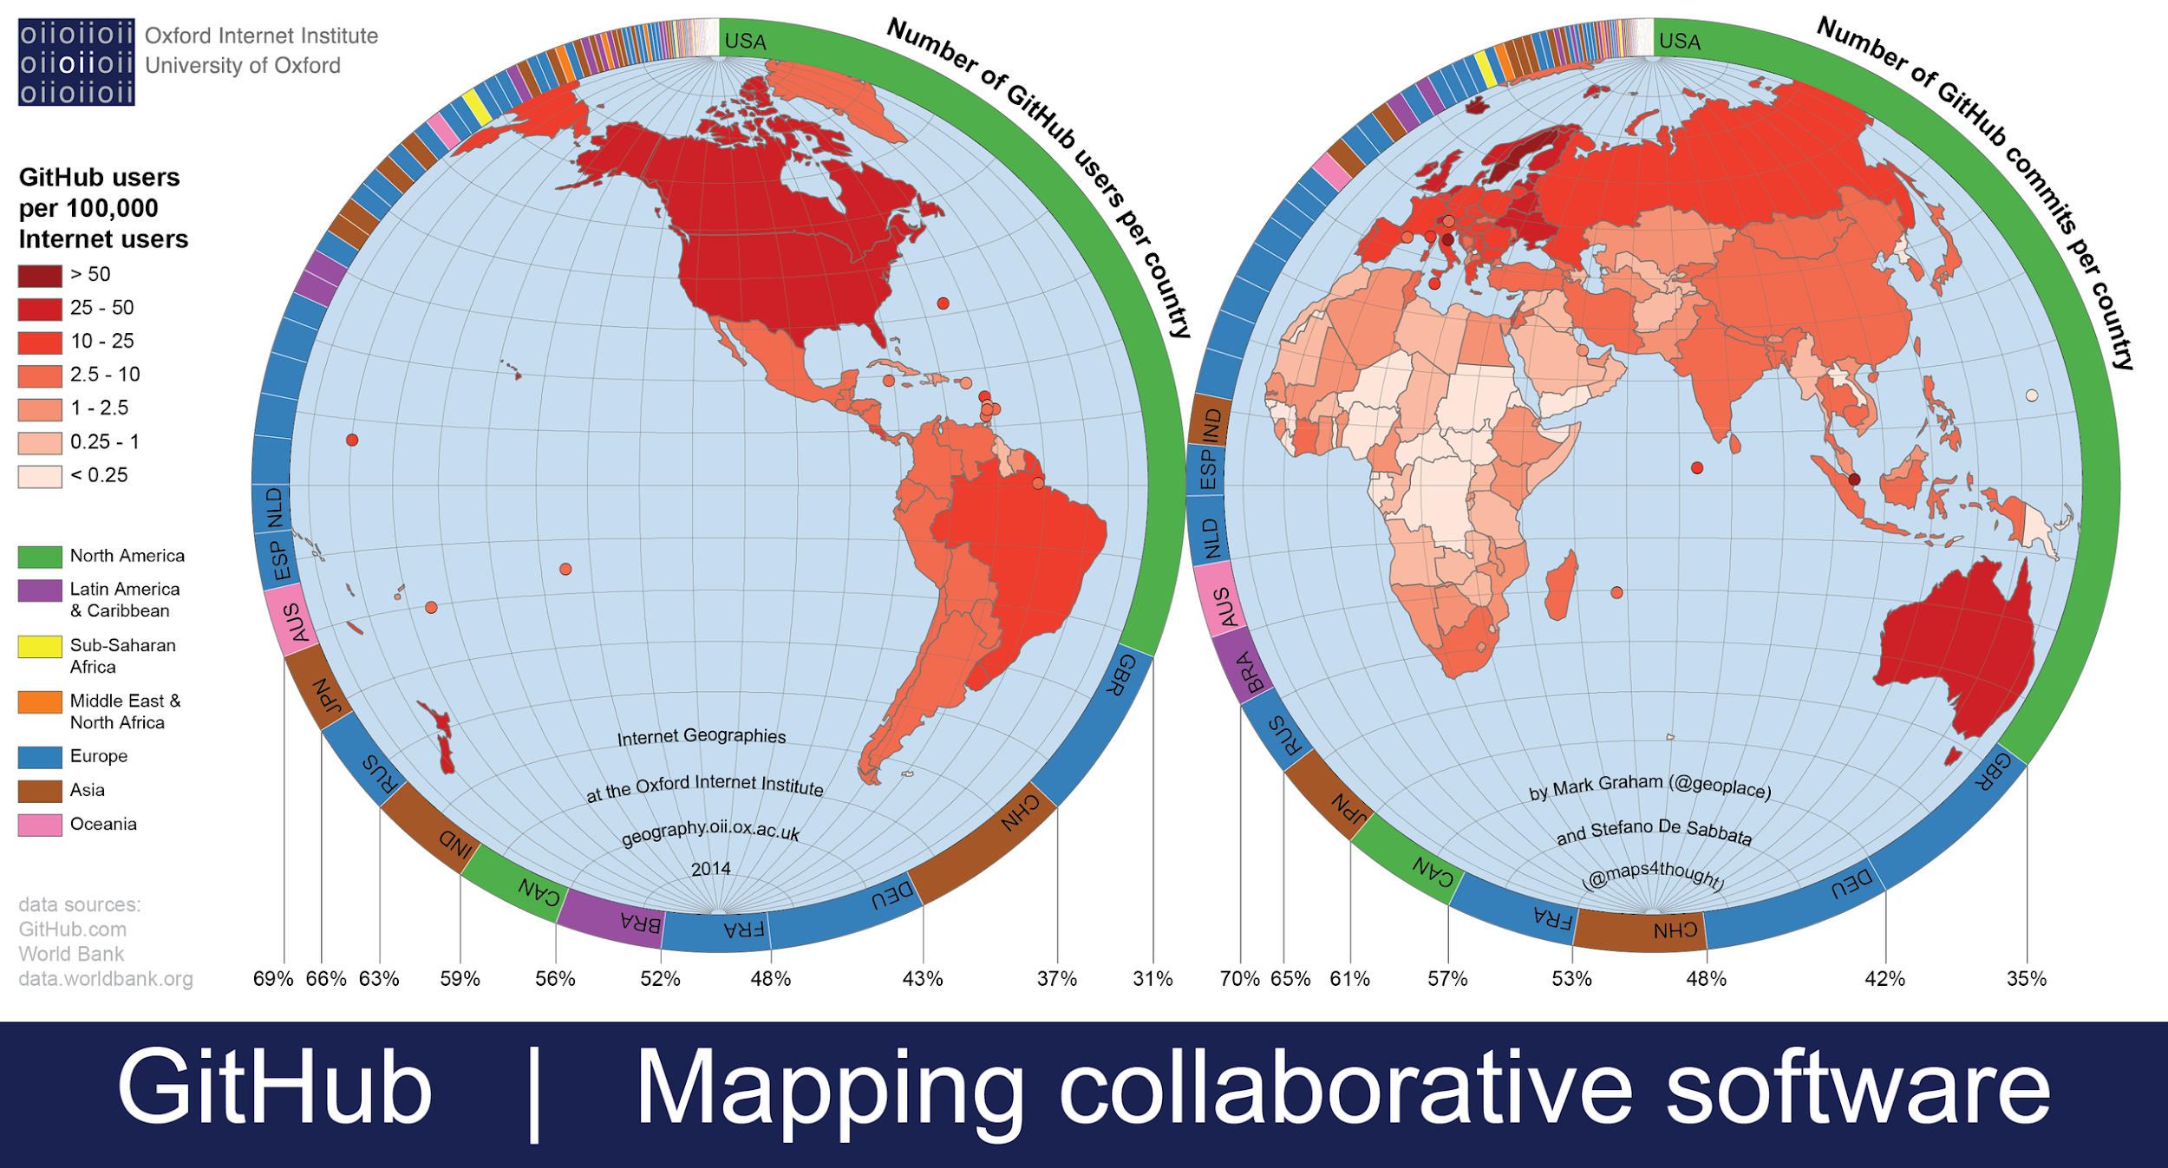

GitHub
GitHub is an American company that provides hosting for software development version control using Git
Git is a distributed version-control system for tracking changes in source code during software development. It is designed for coordinating work among programmers, but it can be used to track changes in any set of files. Its goals include speed, data integrity, and support for distributed, non-linear workflows.
Development
Git development began in April 2005, after many developers of the Linux kernel gave up access to BitKeeper
Linus Torvalds wanted a distributed system that he could use like BitKeeper, but none of the available free systems met his needs.
The development of Git began on 3 April 2005. Torvalds turned over maintenance to Junio Hamano, a major contributor to the project. Hamano was responsible for the 1.0 release on 21 December 2005 and remains the project's maintainer.
By Stefano.desabbata - Own work, CC BY-SA 4.0

Slide 4

Практикуемся !

